Slide 1
Customer Relationship Management (CRM) – Loyalty and Churn
Oliver J. Rutz
UW Foster School of Business

Slide 2
INTERESTING
Greetings from University Readers!
In a constant effort to improve our services, we would love to hear how we did with your recent custom publishing project with us. If you have taken our surveys before, we’ve adjusted it slightly, and we sincerely appreciate your input again.
We greatly value your opinion and will use them to better serve you and your students. This survey is confidential and the results will not be shared with anyone.
Below is the link to the survey, which should take about 2-5 minutes to complete.
https://www.surveymonkey.com/s.aspx?sm=SUaK6J6FE_2b6bEuVv_2baqNkA_3d_3d
Upon completion, we will donate $2 to one of three charities of your choice - Habitat for Humanity, Susan G. Komen Breast Cancer Foundation, United Nations Children's Fund (UNICEF).
Your participation is greatly appreciated! If you have any questions about the survey, please do not hesitate to contact me at cpaguyo@universityreaders.com or 800.200.3908 x518.
Regards,
Celina Paguyo
Marketing Program Manager
University Readers, Inc.
https://www.surveymonkey.com/optout.aspx?sm=SUaK6J6FE_2b6bEuVv_2baqNkA_3d_3d

Slide 3
AGENDA
Some Thoughts on Loyalty
Stage 4 – Churn
Modeling Churn
Other Popular (Classification) Models

Slide 4
WHO TO FOCUS ON …
Some Loyalty facts…
Two types of customers
– Transactional Buyers are always shopping for the best price → They have no loyalty.
– Relationship Buyers are looking for a friendly institution that treats them well and provides good service
– Relationship buyers will stick with you when your prices go up
– Transaction buyers will leave for a dime’s worth of difference
Loyalty and Affluence
– Wealthy customers are more loyal
– 92% of $125K+ are in airline loyalty programs compared to 51% of all
– Wealthy customers do not want discounts. They want status and perks
3
Notes:
3

Slide 5
WHO TO FOCUS ON … – EXAMPLE
Net Customer Promoter Index*
Ask all customers a simple question: “How likely are you to recommend this company (brand, product,…) to a friend and/or colleague?”
Extremely likely 10 9 8 7 6 Neutral 5 4 3 2 Not at all likely 1
Promoters
Need to grow these customers
Passively satisfied
Detractors
* Frederick Reichheld, “The Loyalty Effect”
4
Notes:
4

Slide 6
WHO TO FOCUS ON … – EXAMPLE
Net Customer Promoter Index*
41 - 24 = 17 – that is your net promoter index
Average of 400 companies was 16
eBay, Amazon scored 75 to 80
* Frederick Reichheld, “The Loyalty Effect”
5
Notes:
5

Slide 7
LOYALTY PROGRAMS – FLAWS
Most loyalty programs in U.S. retail are badly flawed
• Oftentimes, loyalty programs are merely volume discount programs that just end up adding costs and reducing profits: Safeway USA, Asda UK
• Supermarkets give away at lower price what their principal customers would have bought anyway; the primary beneficiaries are the “worst customers”
• Markets often cornered into a Prisoner’s Dilemma situation (what’s that?)
• The best customers ought certainly to be rewarded but rewarding by discounts is very expensive
– Instead: reward via instruments that are low value to the firm but high value to the customer
6
Notes:
6

Slide 8
LOYALTY PROGRAMS - REWARDS
Issues in the Design of Reward Structure
• Hard vs. Soft rewards - What is the currency? Points, Discounts, Information, Privilege?
– Price reductions, promotions, free products
– Soft rewards: psychological benefit of having special status, higher service levels
• Ratio of reward value over transaction volume
• More-of-the-same? Or More of something-else?
• Hedonic vs. utilitarian rewards
– Mercedes Benz’ LP offers a flight in a MIG 29 combat aircraft
– Neimann Marcus’s “wow and cool” rewards: a world famous photographer to come to a customers home for taking pictures
• Tiering and Timing of rewards: how rewards accumulate as a function of time and spending behavior. Bigger the “chunks” . . . (1) greater customer retention (2) greater “breakage” but also (3) lower start-up rates and hence the need to jump-start
• Offering ability to combine program currency with real currency
• Rewarding profitability versus rewarding volume
7
Notes:
7

Slide 9

LOYALTY PROGRAM – EXAMPLE (CON’T)
Example – Insurance Company
Create personal notes from agents
Need to grow these customers
Dear Bob & Kitty:
As I figure it, you could save
about $206 per year on your
auto premium. Call me today!
Susan
8
Notes:
8

Slide 10
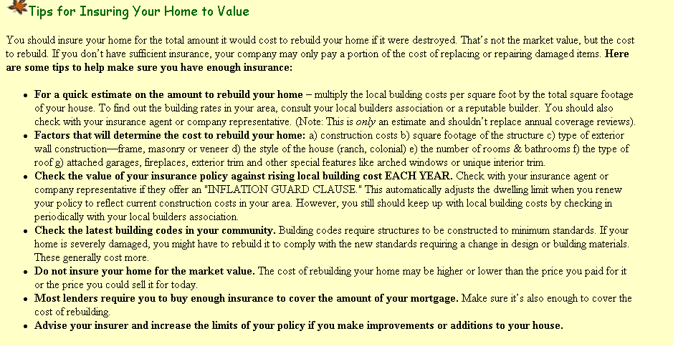
LOYALTY PROGRAM – EXAMPLE (CON’T)
Example – Insurance Company
Automatic follow up note
Dear Bob & Kitty
I haven’t heard from
you on the letter on
the new homeowner’s
policy. The savings
on your auto policy
are terrific. Call me.
Susan Hughes
Need to grow these customers
9
Notes:
9

Slide 11
LOYALTY PROGRAM – EXAMPLE (CON’T)
Example – Insurance Company
How did it work?
89% of agents invited went to web and participated.
52% created personal notes
Recipient HH bought 11% more than the controls
Follow-up letter created 8% more sales
Follow-up phone call gained 43% more
Personal notes increased sales by 140%
Model prediction: Top decile sales 68% over average and 195% over bottom decile.
? PROBLEMS ?
Need to grow these customers
10
Notes:
10

Slide 12
GENERAL PROBLEMS
The E-word: Endogeneity
A problem arises in your design if the treatment is NOT RANDOM
Selection Bias
Which agents decide to send post-it?
Informed Decision
Have some insight in response behavior and only target the responsive segment
Firms know about response when setting price – they are NOT randomizing prices, e.g., you will never see that Milk costs either $0.05 or $100 per gallon
Vicious Circle
Advertising drives sales (hopefully, we all agree on that)
However, sales drive advertising (if you make more money, you can spend more money)
11
Notes:
11

Slide 13
EXAMPLE – CASINO LOYALTY PROGRAM
Consulting Project
Client: Casino Chain in Las Vegas
Task: Evaluate ROI of Loyalty Program
Focus on one aspect of program: Free Hotel Room (Cost to Casino $200)
Data
play: Revenues for a sample of consumers
reward: dummy variable indicating whether a consumer got a free room or not
12
Notes:
12

Slide 14
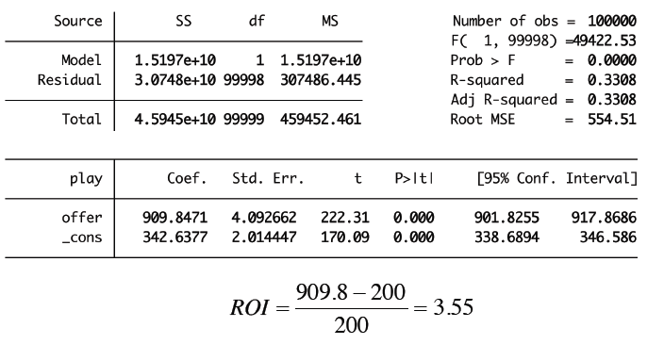
EXAMPLE – CASINO LOYALTY PROGRAM
Consulting Project
• Regression of reward on play (very simple)
Seems to be working well
13
Notes:
13

Slide 15
EXAMPLE – CASINO LOYALTY PROGRAM
Consulting Project
• Marketing Variables set based on expected outcome – Casino gives more to heavy gamblers
14
Notes:
14

Slide 16
EXAMPLE – CASINO LOYALTY PROGRAM
Consulting Project
• Marketing Variables set based on expected outcome – Casino gives more to heavy gamblers
Problem: Reverse Causality
Free rooms seems to cause more gambling
What do we do?
Marketing variables are often set based on some discrete cutoffs on underlying continuous variables
Offers are given based on past gambling volumes
E.g. gamblers who gambled more than $500 per day on average in the past get the offer
15
Notes:
15

Slide 17
REGRESSION DISCONTINUITY
Quasi Experiment
People just below the cutoff are very similar to the people just above the cutoff
Only difference is the offer they were given
Comparing these two groups gets an answer “close to” the causal effect
How to do this
Include only “a few” observations above and below this cutoff rank in the regression
16
Notes:
16

Slide 18
EXAMPLE – CASINO LOYALTY PROGRAM
Regression Discontinuity
A very different picture emerges
Not working so well
17
Notes:
17

Slide 19
EXAMPLE – CASINO LOYALTY PROGRAM
Regression Discontinuity
When marketing variables are set based on some expected outcome
When there is a discrete cutoff based on which the marketing variable is set
Regression discontinuity is based on running the regression for the people just below and just above the cutoff
In this example
Naïve regression results suggested that a dollar invested in the offer generated $3.55 in net profits
Regression Discontinuity results suggested that a dollar invested in the offer caused a net loss of $2.58
18
Notes:
18

Slide 20
AGENDA
Some Thoughts on Loyalty
Stage 4 – Churn
Modeling Churn
Other Popular (Classification) Models

Slide 21
CUSTOMER EVENTS AND MARKETING INTERVENTIONS
Lifecycle
Prospects
Early Buyers
Core Customer
Defectors
Marketing
Acquisition
Development
Retention
Winback
Voluntary Churn
If high value: winback campaign
Otherwise no action
Forced Churn

Slide 22
STAGE IV – FOCUS ON DEFECTION
Stage IV of the Customer Lifecycle
Managerial Issues
A firm’s best customers are
its competitors’ most sought-after prospects
21
Notes:
21

Slide 23
DEFECTION RATES VARY ACROSS INDUSTRIES
Defection rates
Annual Defection rates in some industries:
• Cellular 25-35%
• Retail Banking 40%
• Clothing catalogs: 25%
• Residential tree and lawn care: 32%
• Newspaper subscription: 66%
22
Notes:
22

Slide 24
WHY DO CUSTOMERS DEFECT?
Reasons for Customer Defections
Why do customers leave?
Reasons cited in a Rockefeller study on defections:
• 14 percent: complaints not handled properly
• 9 percent: competition
• 9 percent: relocation
• 68 percent: no particular reason
Relationships typically end as a slow leak rather than a blow-out
23
Notes:
23

Slide 25
HOW TO MANAGE CHURN
Managing Churn
• Untargeted Approach: Product quality, mass advertising, branding
• Targeted Approach
– Reactive: Wait for customer to call
– Proactive: Contact customer in advance
• Targeted proactive approach has advantages:
– Less expensive than untargeted
– Offer does not have to be as large as reactive
– Rewards being a customer, not being a churner
• But, requires accurate prediction of churn probability
24
Notes:
24

Slide 26
FOCUS ON RETENTION IN STAGE 3
Customer Retention
Three important elements to consider:
Customer perceptions
Measurable customer experience
Customer behavior (as opposed to stated intentions about behavior)
Study the links between:
Customer perceptions and churn
Real performance and churn
25
Notes:
25

Slide 27
MARKETING FOCUS
Which Firms Should Emphasize Acquisition vs. Retention
All firms need to direct effort to acquisition
However, the optimal effort depends on the responsiveness of retention to marketing effort. The lower this responsiveness, the higher the effort to be directed to acquisition.
Low Retention, Low Responsiveness
Used card dealerships
High Retention, Low Responsiveness
Banks
26
Notes:
26

Slide 28
MARKETING FOCUS
Acquisition Pricing vs. Retention Pricing
Commonly followed strategy: Price low to acquire and raise prices later
• Higher the maximum retention potential, lower the introductory price
• Higher the price-elasticity of acquisition, lower the introductory price
However:
• Low introductory prices can greatly influence expectations on subsequent pricing
• If the acquisition price is too low relative to retention price, customers are less likely to repurchase
27
Notes:
27

Slide 29
AGENDA
Some Thoughts on Loyalty
Stage 4 – Churn
Modeling Churn
Other Popular (Classification) Models

Slide 30
NEURAL NETWORKS – EXAMPLE
Example with one predictor variable
Linear?
Continuous?
29
Notes:
29
\

Slide 31
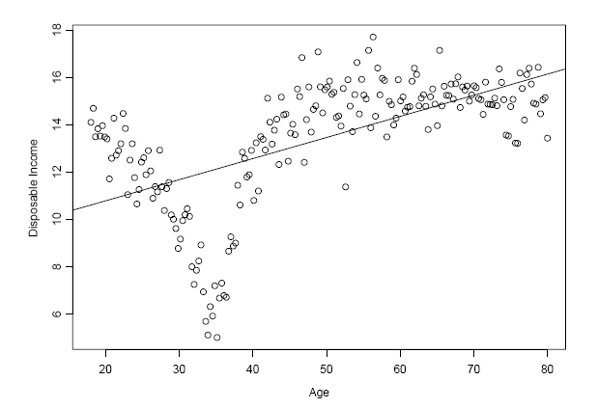
NEURAL NETWORKS – EXAMPLE (CON’T)
Data shown with linear regression fit
This seems NOT to be a GOOD MODEL
30
Notes:
30

Slide 32
NEURAL NETWORKS – EXAMPLE (CON’T)
Data shown with piecewise linear regression fit
Example in Graph has 2 CUT-OFF lines and 3 SECTIONS
CUT-OFF Line
SECTION
31
Notes:
31

Slide 33
NEURAL NETWORKS – EXAMPLE (CON’T)
A three-hidden-unit network
Basically, we need a model that does 2 things
Find the CUT-OFF lines
Estimate the linear model for each SECTION
Example in Graph has 2 CUT-OFF lines and 3 SECTIONS
CUT-OFF Line
SECTION
32
Notes:
32

Slide 34
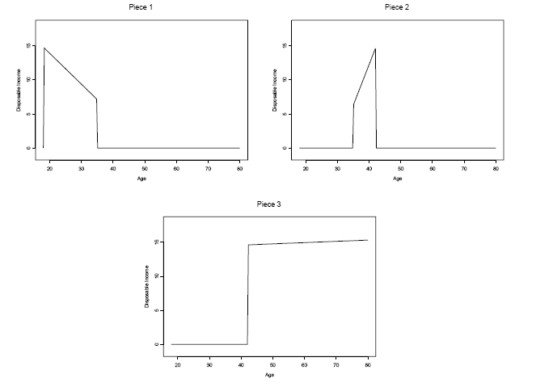
NEURAL NETWORKS – EXAMPLE (CON’T)
The piecewise linear fit is the sum of three separate
localized linear curves
33
Notes:
33

Slide 35
NEURAL NETWORKS – THEY WORK
Why are neural networks widely used?
Neural networks can approximate most functions very well, because:
• Most functions can be approximated very well with piecewise linear functions
• Any piecewise linear function can be approximated very well with neural networks
Approximation by piecewise linear functions
• Break up the data into mutually exclusive regions
• Fit a linear regression model separately in each region
34
Notes:
34

Slide 36
CHURN – EXAMPLES
An illustration: churn modeling in cellular service
The 3 big application areas:
• Mobile phone services
• Home mortgage refinance
• Credit Card
Because
• Costs of customer acquisition and win-back can be high
• Much cheaper to invest in customer retention
• Difficult to recoup costs of customer acquisition unless customer is retained for a minimum length of time
35
Notes:
35

Slide 37
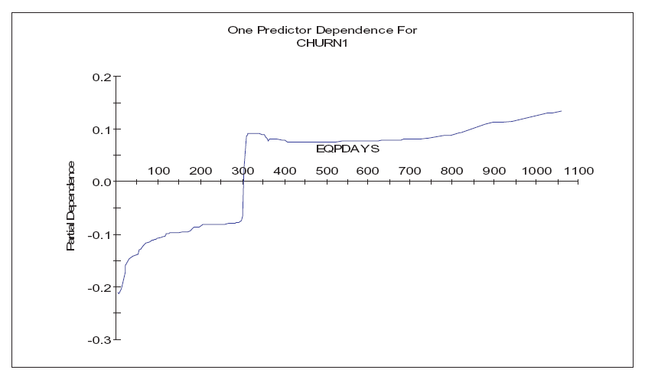
CHURN – EXAMPLES
Impact of Hand Set Age
36
Notes:
36

Slide 38
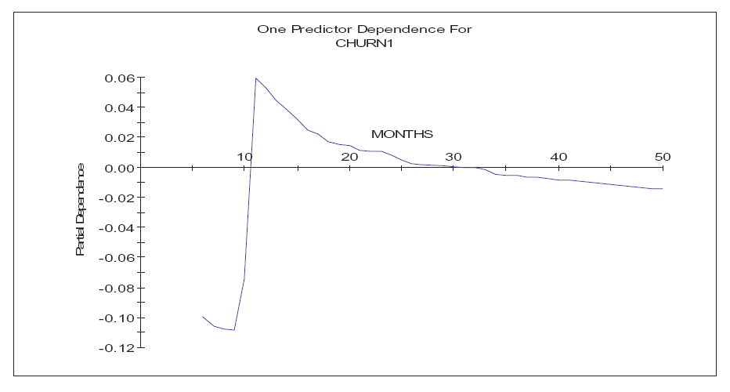
CHURN – EXAMPLES
Effect of Tenure
37
Notes:
37

Slide 39
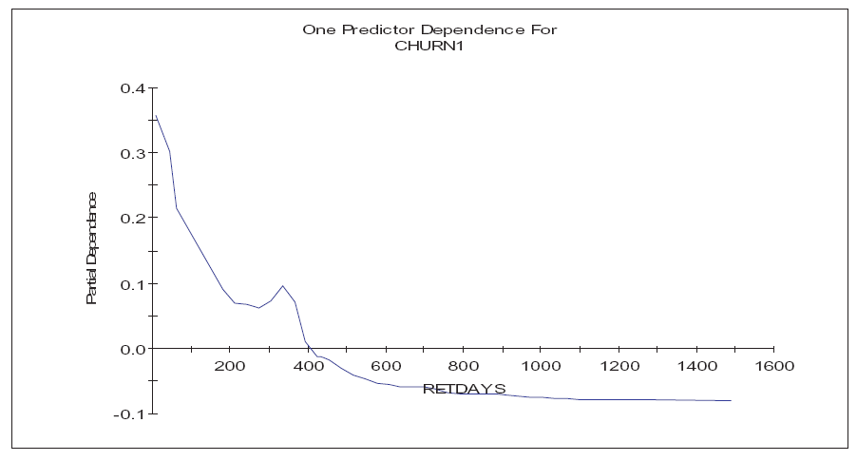
CHURN – EXAMPLES
Impact of Time Since Retention Call
38
Notes:
38

Slide 40
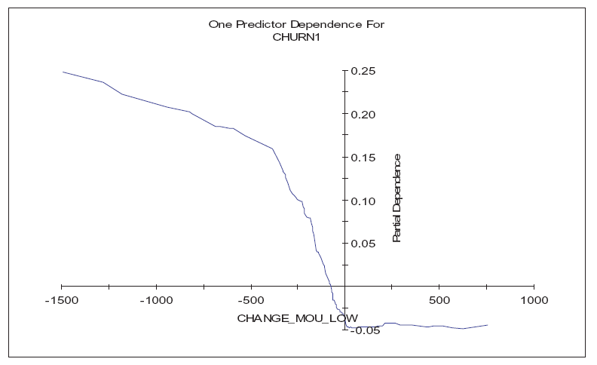
CHURN – EXAMPLES
Impact of Recent Change in Minutes Usage
39
Notes:
39

Slide 41
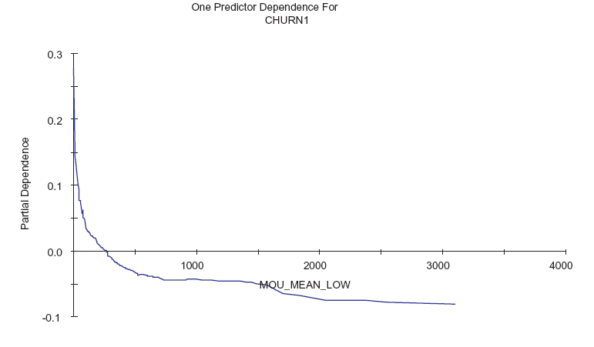
CHURN – EXAMPLES
Effect of Usage Level
40
Notes:
40

Slide 42
AGENDA
Some Thoughts on Loyalty
Stage 4 – Churn
Modeling Churn
Other Popular (Classification) Models

Slide 43
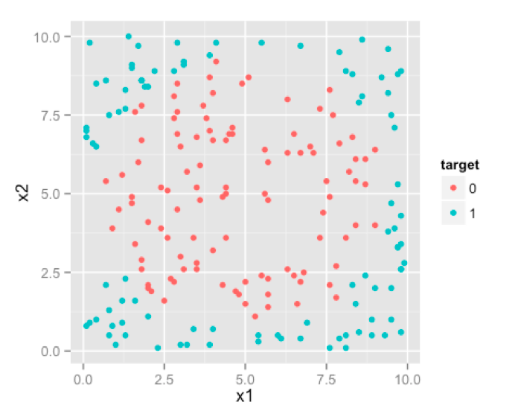
CLASSIFICATION PROBLEM
We want to classify outcomes (e.g., 0 or 1)
As we have discussed, most decisions of interest are 0/1.
For our discussion, let’s say we have one output (or target) variable y that is 0/1
We have two input variables, x1 and x2.
That’s what the classification problem looks like
Can we use x1 and x2 to understand/predict whether y is 0 or 1?
42
Notes:
42

Slide 44
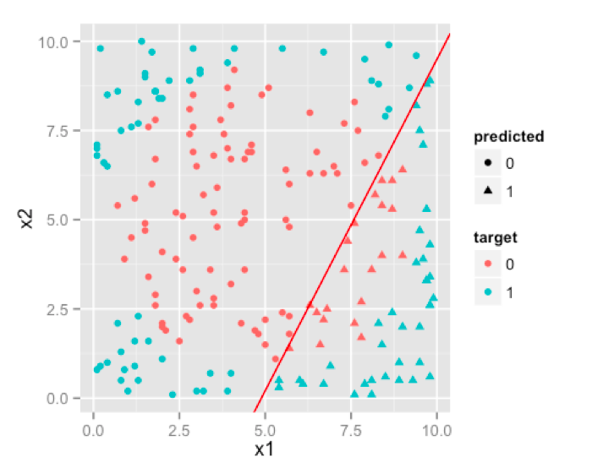
CLASSIFICATION PROBLEM
Logistic Regression
Our workhorse model
Appealing behavioral framework -> recall S-shape and the insights that consumers with STRONG preferences are hard to move and consumer in the “middle” are movable.
Even so S-Shape, decision boundaries are linear
For our data, this seems a rather poor model – not separating 0/1 very well
43
Notes:
43

Slide 45
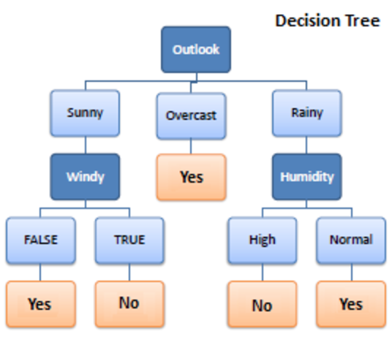
CLASSIFICATION PROBLEM
Decision Trees
Model outcome as steps of decisions
Going down a branch of the tree describe one set of decisions
For example, a decision tree for playing golf.
Often issue here is that complex decision trees with many branches and deep (i.e., long) branches overfit the data (i.e., predict very poorly)
44
Notes:
44

Slide 46
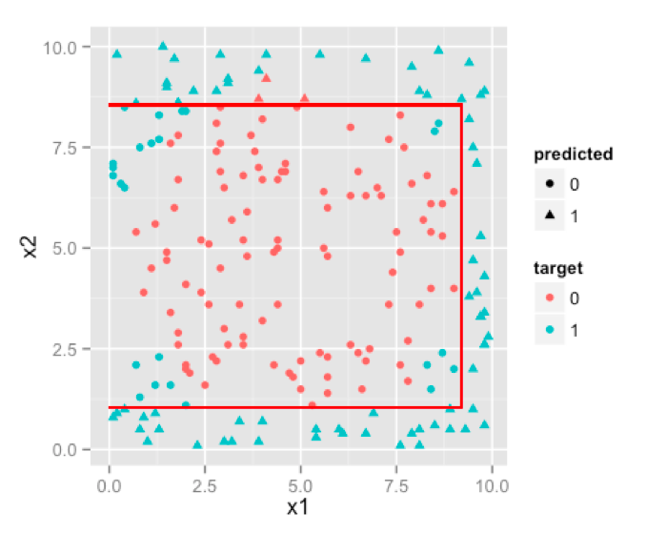
CLASSIFICATION PROBLEM
Decision Tree
Provides Decision Boundaries parallel to axis
For our setting x1<8.5 is one rule and 1.25<x2<8.25 is a second one
This seems to be fitting our data rather well
45
Notes:
45

Slide 47
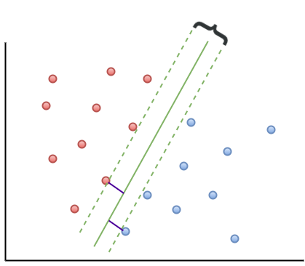
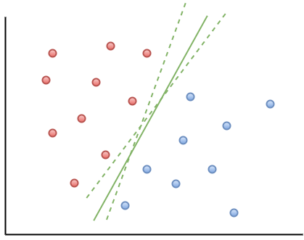
CLASSIFICATION PROBLEM
Support Vector Machines
Very flexible model BUT somewhat harder to explain/make sense of
Key idea is to split space using an “optimal” decision boundary
The algorithm only uses the points closest to the line as support vectors instead of ALL of the data as all other models (purple lines, right graph)
What happens if the data are not separable by a line?
KERNELs are metrics that transform a space into a different one. This allows to make a model very flexible and make “linear” problems non-linear
46
Notes:
46

Slide 48
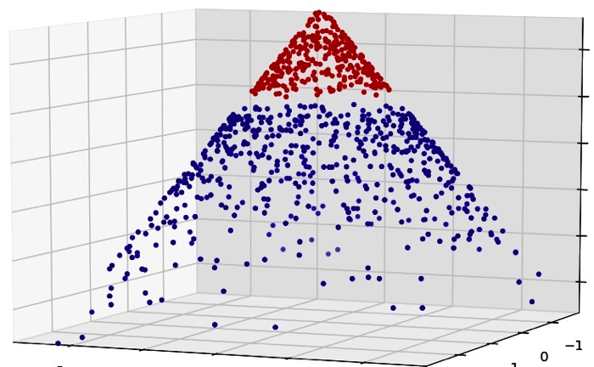
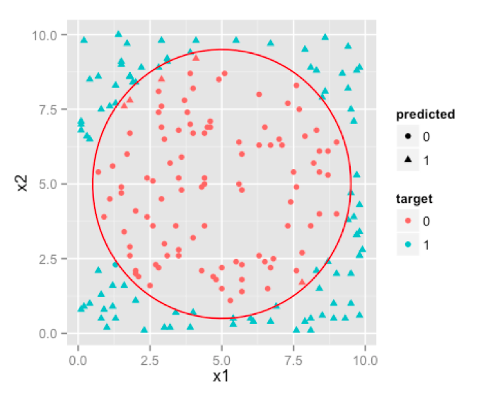
CLASSIFICATION PROBLEM
Support Vector Machines
A Kernel projects the feature space (in our case 2-D) into kernel space (here 3-D) and makes the classes linearly separable.
So a Kernel adds an extra dimension!
How do we find the best Kernel? We simply try a few standard ones (comes with your package in R) and pick the best fitting model!
Fits the data even better than the Decision Tree
47
Notes:
47

Slide 49
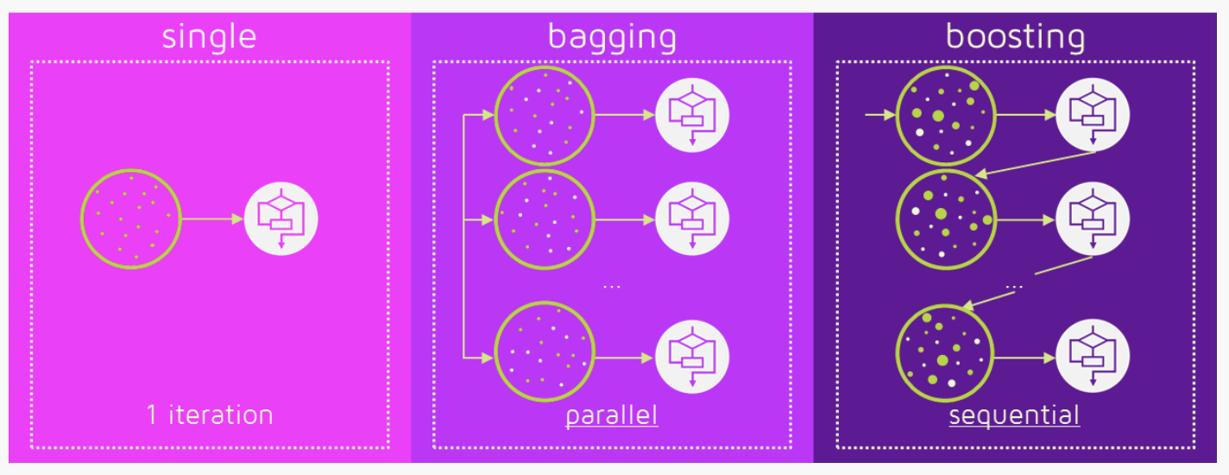
MODELS OF MODELS
Using Multiple Models instead of ONE Model
Bagging
Simple ensemble method in which many independent models (these are often called learners) are used together with model averaging techniques (e.g., weighted average).
Boosting:
Boosting is a more complex ensemble method in which the predictors are not made independently, but sequentially. In each step the prediction is updated a little bit (using a learning rate).
48
Notes:
48

Slide 50
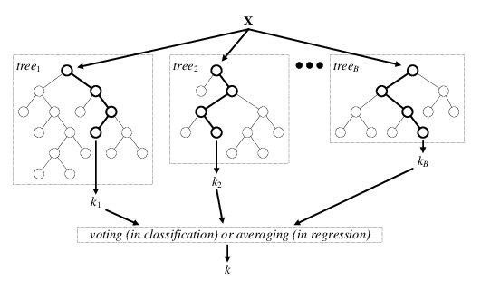
ENSEMBLE METHODS – BAGGING
Random Forest
Key idea is to fix overfitting of Decision Trees by replacing ONE complex tree with many smaller trees (Forest)
Two key steps make a Random Forest better than a single Decision Tree
Random sampling of training data when building trees
Random subsets of features for splitting nodes
Final prediction is made by AVERAGING over all trees
49
Notes:
49

Slide 51
ENSEMBLE METHODS – BOOSTING
Gradient Boosted Trees or Gradient Boosting Machine (GBM)
Key idea is to fit a sequence of small trees that learn over time
Basic Sequential Algorithm
Step 1:
Initial prediction: y_hat_1 = mean(y)
Calculate error for next step: eps_1 = y – y_hat_1
Step 2: Run small tree with eps_1 as target. Get fitted values based on tree: eps_1_hat.
Update prediction: y_hat_2 = y_hat_1 + delta* eps_1_hat
Calculate error for next step: eps_2 = eps_1-eps_1_hat
Step 3: Run small tree with eps_2 as target. Get fitted values based on tree: eps_2_hat.
Update prediction: y_hat_3 = y_hat_2+ delta*eps_2_hat
Calculate error for next step: eps_3 = eps_2-eps_2_hat
Continue until some convergence criteria is satisfied.
Current Prediction after Step 1
Learning Rate
Learning in Step 2
50
Notes:
50

Slide 52
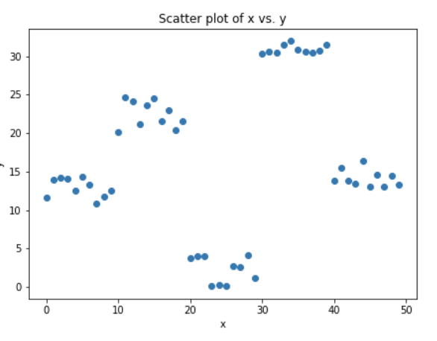
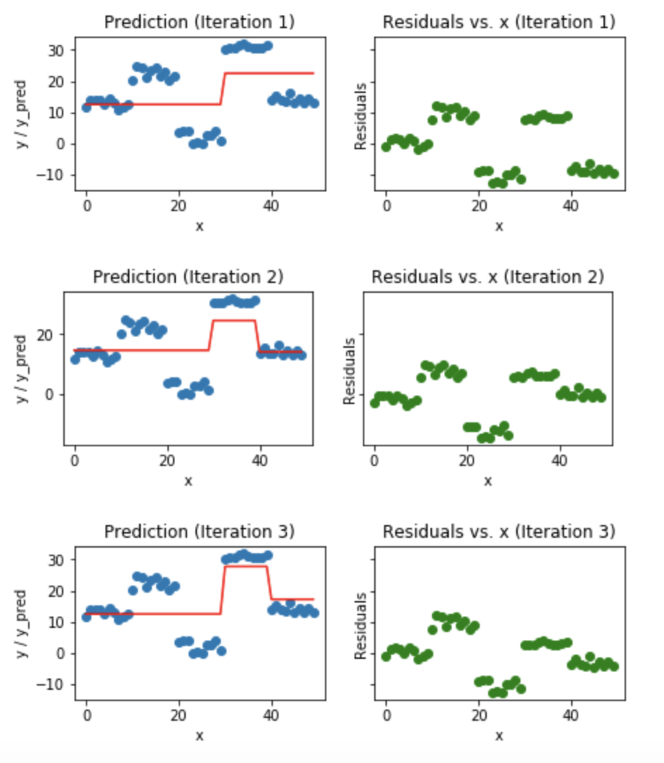
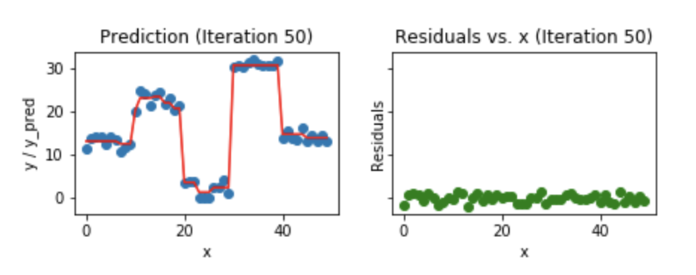
ENSEMBLE METHODS – BOOSTING
Data for our model y = f(x)
For all models we discussed so far these data look “bad”
Iteratively Fitting a Learning Model
This seems to be fitting our data rather well
51
Notes:
51

